Slide 1
Bank Rental Prediction
May 2022

Slide 2
Problem Identification:
Goal of this project is to build a reliable prediction model
City of Washington D.C. provides bike rentals for its residents and wishes to analyze and predict demand for units on hourly basis

Slide 3
Criteria for Success:
Develop a prediction model that will give an estimate on the number of needed bikes per hour
Test several regression models and choose the most accurate one
This will be done by studying the relationship between the features and the target variable (count of rented bikes)

Slide 4
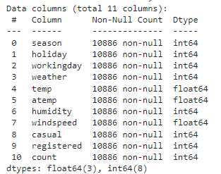
Features Break-down with data types, not including timestamp

Slide 5

DATASET CLEANING
Available data contains two sets – train.csv and test.csv
Train dataset contains 12 features and 10886 records
Found no missing values
Datetime feature (timestamp) set as index
All other features numerical
Extracted datetime feature into individual year, month, day, dayofweek, hour features

Slide 6
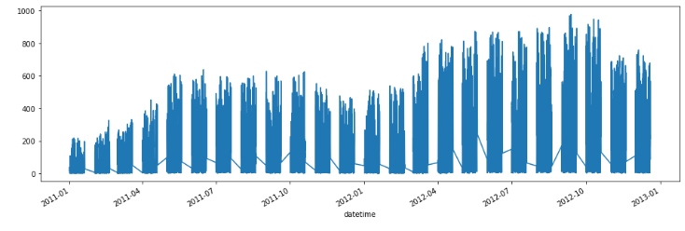
Modeling & Analysis:
Target distribution over time
As expected, number of rentals grows over the summer and peaks in the fall.

Slide 7
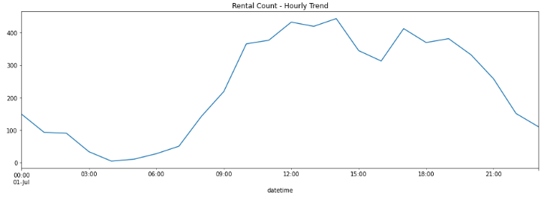
Modeling & Analysis:
One of the busiest months, July, and hourly trend shows that people rent bikes the most between 11am and 2pm, with a relatively small decline until 5pm, then climbing again until 7pm, going down from there.

Slide 8
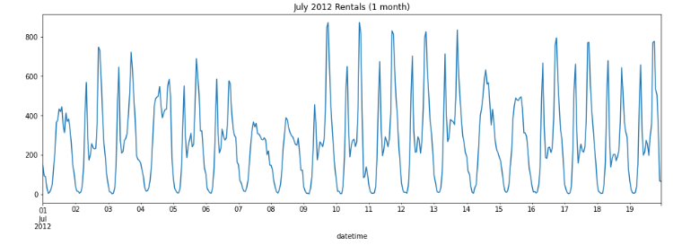
Modeling & Analysis:
A close-up of month July shows slight seasonality every 5 days, possibly means slowing down over the weekend.

Slide 9
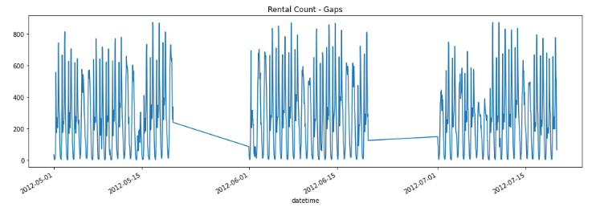
Modeling & Analysis:
Our data has gaps between every 20th and last day of the month

Slide 10
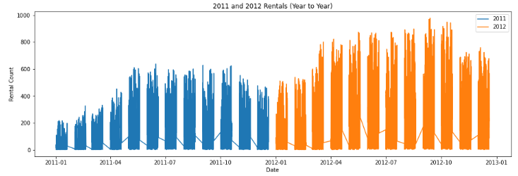
Modeling & Analysis:
Year to year comparison shows significant growing trend over time, and similar distribution over the months in a year.

Slide 11
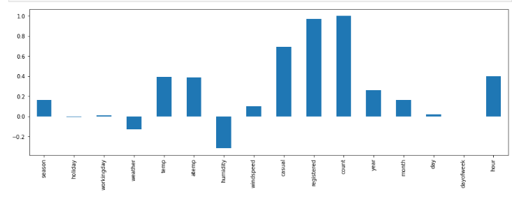
Modeling & Analysis:
Correlation of Features

Slide 12
Key Findings:
Highest positive correlation is between our target and registered users, which will impact our prediction model in a wrong way, so we will drop them.
Temperature and hour with the highest correlation. Humidity affects our target negatively, meaning higher humidity leads to less rentals (probably due to rain).
There are about twice as much registered compared to casual users.
There are many more rentals on workdays compared to holidays.
Most rentals occur when the weather is dry, around 20 degrees C, wind around 12mph

Slide 13
FIT MODELS – Logistic Regression
Fit Linear Regression model to train data and tested it on the test data
Made a pipeline with this model including the scaling step
Evaluated model performance with cross-validation

Slide 14
FIT MODELS – Random Forest
Fit Random Forest model to train data and tested it on the test data
Made a pipeline with this model including the scaling step
Evaluated model performance with cross-validation

Slide 15
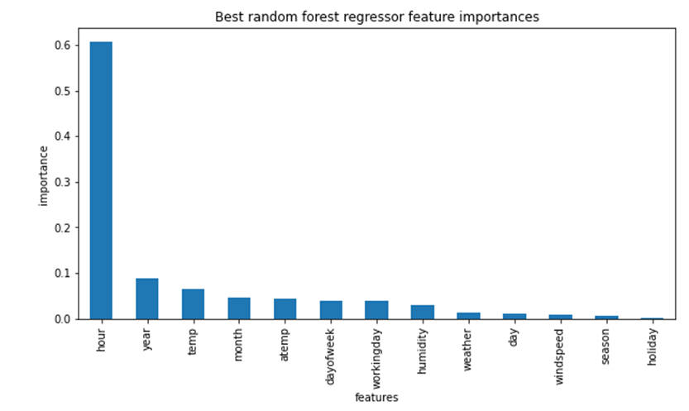
Modeling & Analysis: Important Features

Slide 16
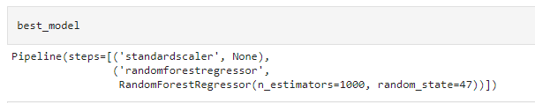
Final Model
Our final model is Random Forest.

Slide 17
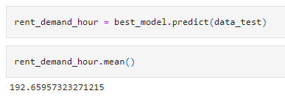
Test the Model

